Slide 1

PEER EVALUATION WEB APP
QUARANTEAM 2020

Slide 2




CONCEPT
Instructors often utilize peer evaluations to evaluate students working on group projects
We created a web application to facilitate this process
Students can log in and fill out peer evaluations
Instructors can log in and view peer evaluations

Slide 3
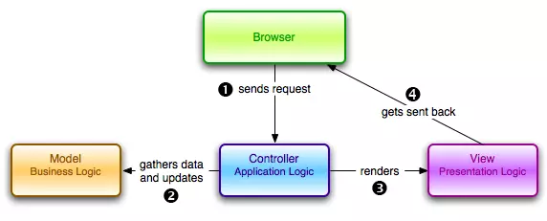
DEVELOPMENT PROCESS

Slide 4


USERS
Students
• View groups, courses, projects and other students
• Create/update peer evaluations
Instructors
Create/read/update/delete courses , groups, and project
Enroll Students to classes and groups
View student peer evaluation

Slide 5
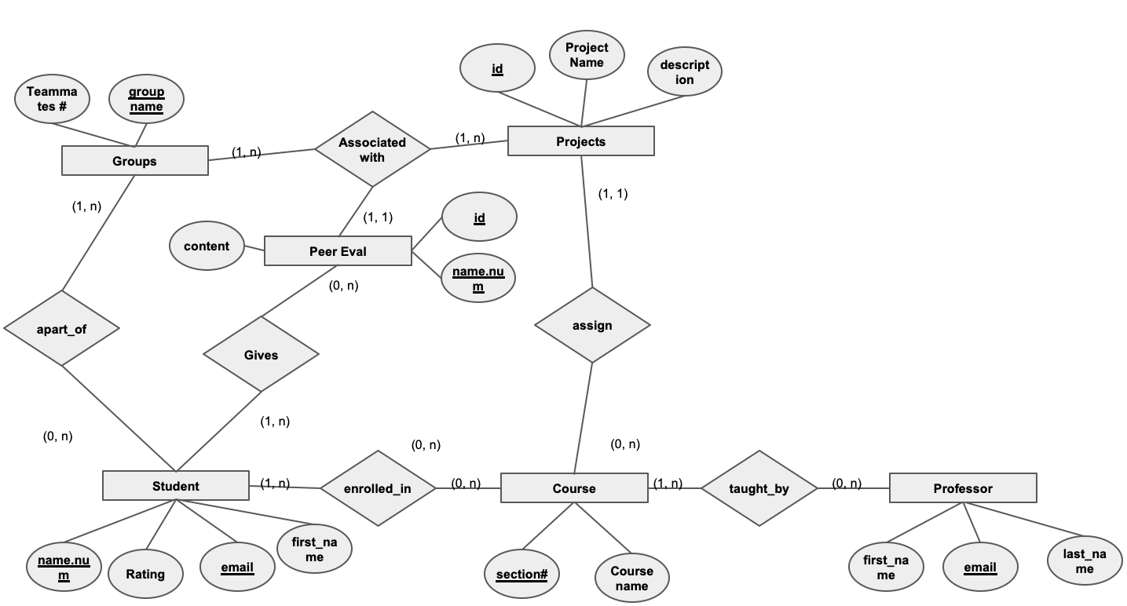
ER DIAGRAM

Slide 6
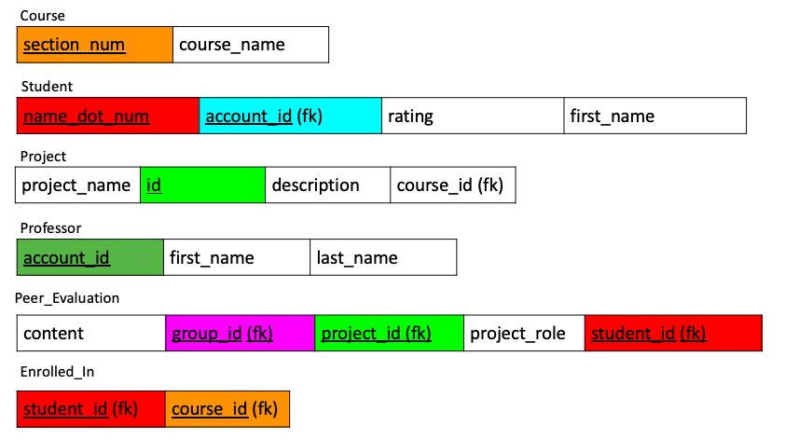

Slide 7
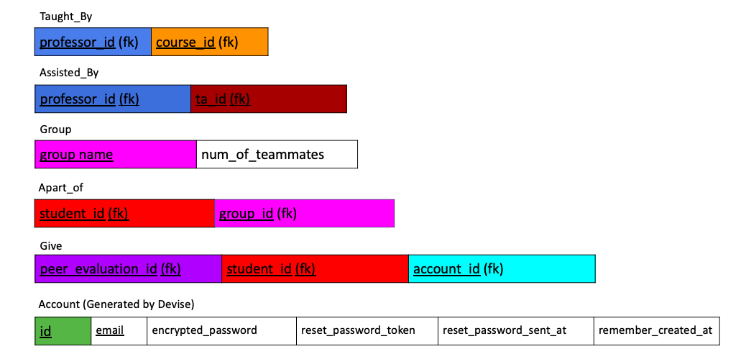

Slide 8
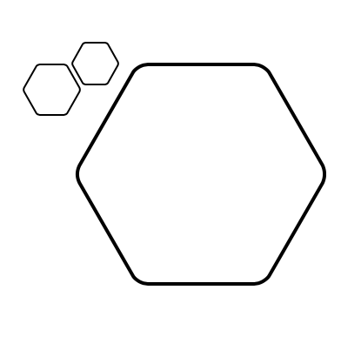
IMPLEMENTATION OF MODEL
We made the following models, each representing a table in our database:
account
apart_of
application_record
assisted_by
associated
course
enrolled_in
give
group
peer_evaluation
professor
project
student
taught_by

Slide 9
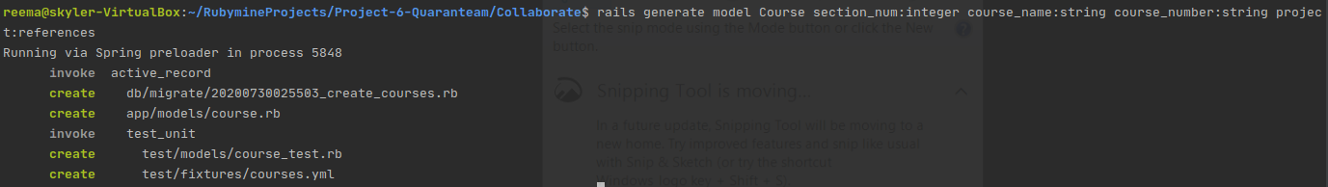
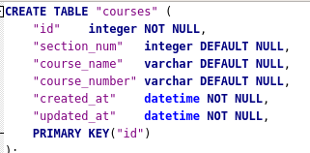
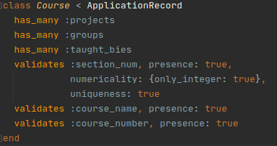
IMPLEMENTATION OF MODEL
rails generate model ModelName was used to automatically generate files for tables in model.
Eg: Generating files for Course
Run rake db:migrate to update the database schema
Notes:
rails g migration AddNameToCourse name:references

Slide 10
Sign up
student
peer_eval
- email
- password
- type of account
(prof/stud)
- list of assigned courses
- list of assigned groups + projects w/ link to view peer evals
- list of members w/ link to create eval
Create peerEval
- fill out form
Assigned Groups
- list of groups w/ links to the peer evaluations for each
- assign groups
- unassign groups
View evals
Sign in
- list of relevant peer evaluations to the group project
- login
- sign up
- retrieve pass
Projects
Prof
- list of assigned proj w/ link to view assigned groups
- lists of courses w/ links to view projects & links to view groups & links to view enrollment
- edit courses
- add courses
- drop courses
groups
Recover pass
- list of groups
- add groups
- remove groups
- edit groups
- add student
enrollment
Add group
- list of students enrolled
- add students
- drop students
Edit group
Add student
STATE DIAGRAM
Add course
Edit course

Slide 11
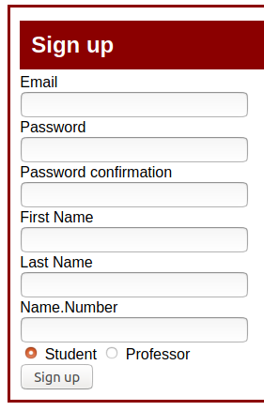
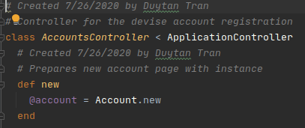
IMPLEMENTATION OF CONTROLLER
Accounts Controller
Provides a new instance of Account accessible to the view
For views related to form

Slide 12
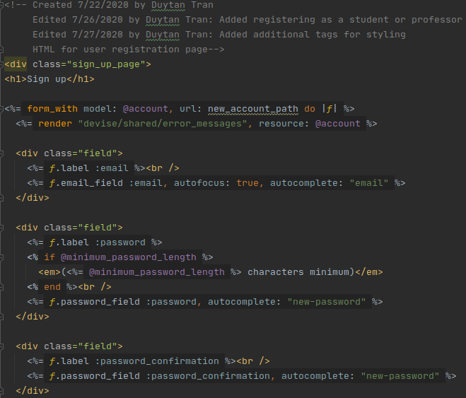
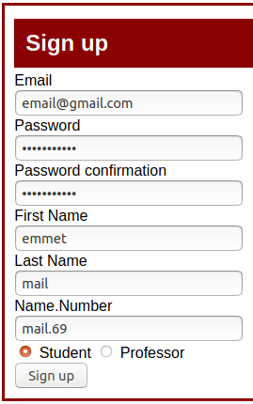
Accounts Controller

Slide 13
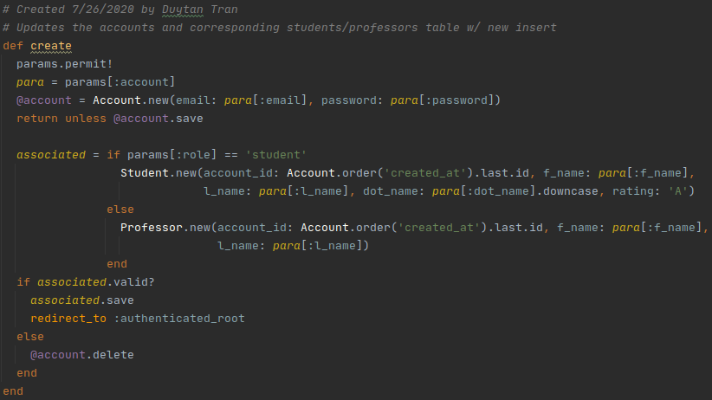
Accounts Controller

Slide 14
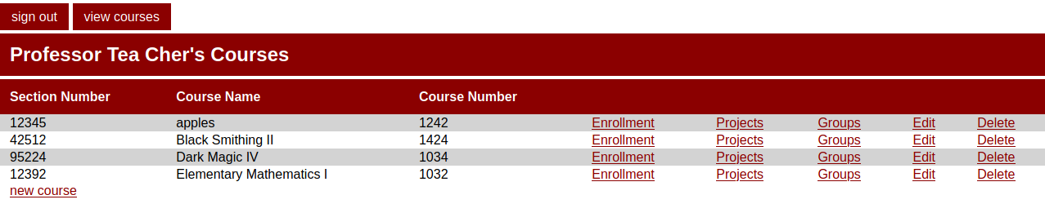
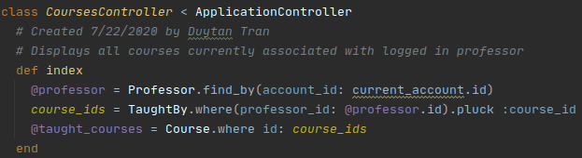
Courses Controller - Index pages

Slide 15
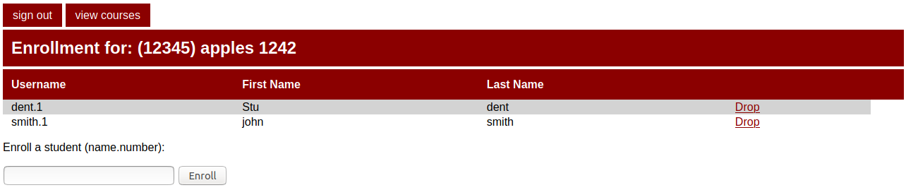
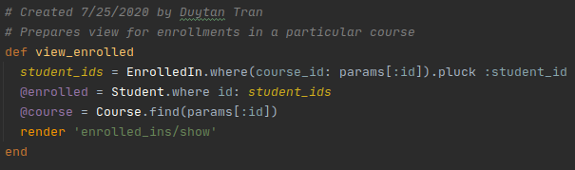
Courses Controller - Show

Slide 16

IMPLEMENTATION OF VIEWS
The views make possible the displaying of information in our database.
We implemented several views for many of our tables.
For example - for our course table we created 4 views.
An HTML form for an instructor to create a new course
The necessary HTML to edit an existing course
The HTML to display courses taught by a specific instructor
The HTML for new course added by the professor

Slide 17
IMPLEMENTATION OF VIEWS
<%= form_with … %>
We utilized form_with for the creation of several forms throughout our views.
To create new user accounts
To create new courses
To create groups
To create projects
For peer evaluation itself

Slide 18
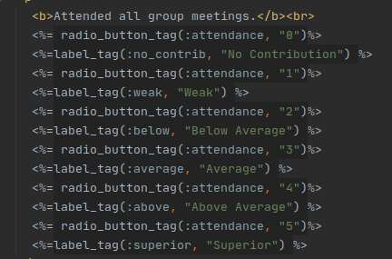
IMPLEMENTATION OF VIEWS
Example from the peer evaluation form using radio buttons within a form.

Slide 19
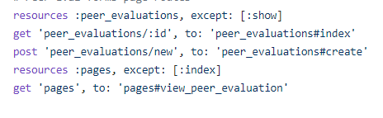
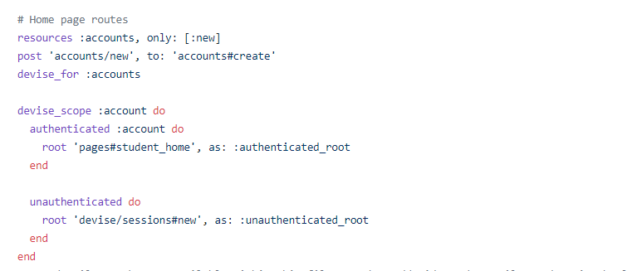
ROUTES
Routes were redirected to the landing page
Use of Devise to create authenticated and unauthenticated root
Additional routes were created to handle different pages

Slide 20
DEMO

